Slide 1
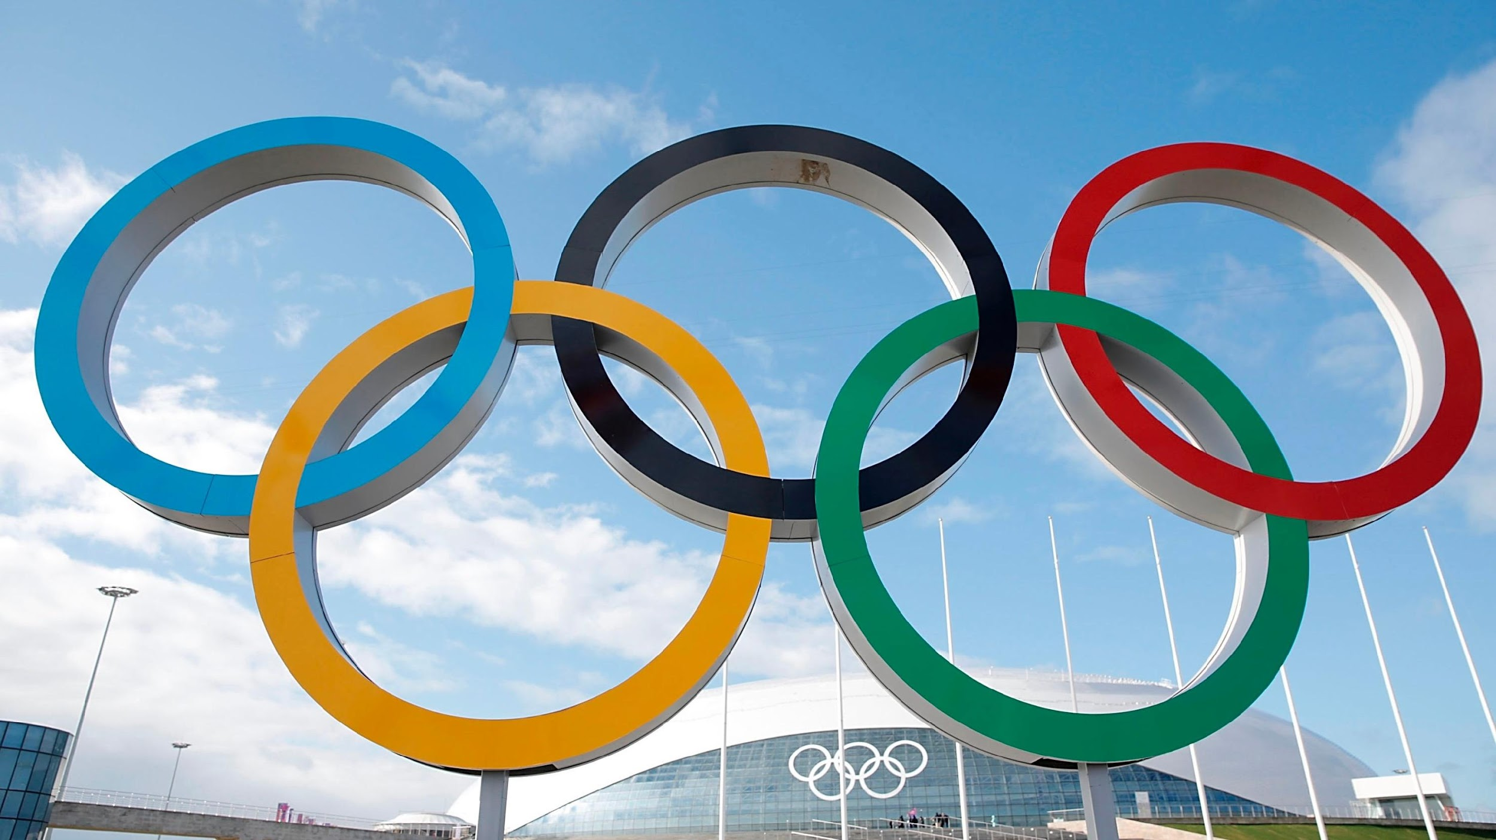
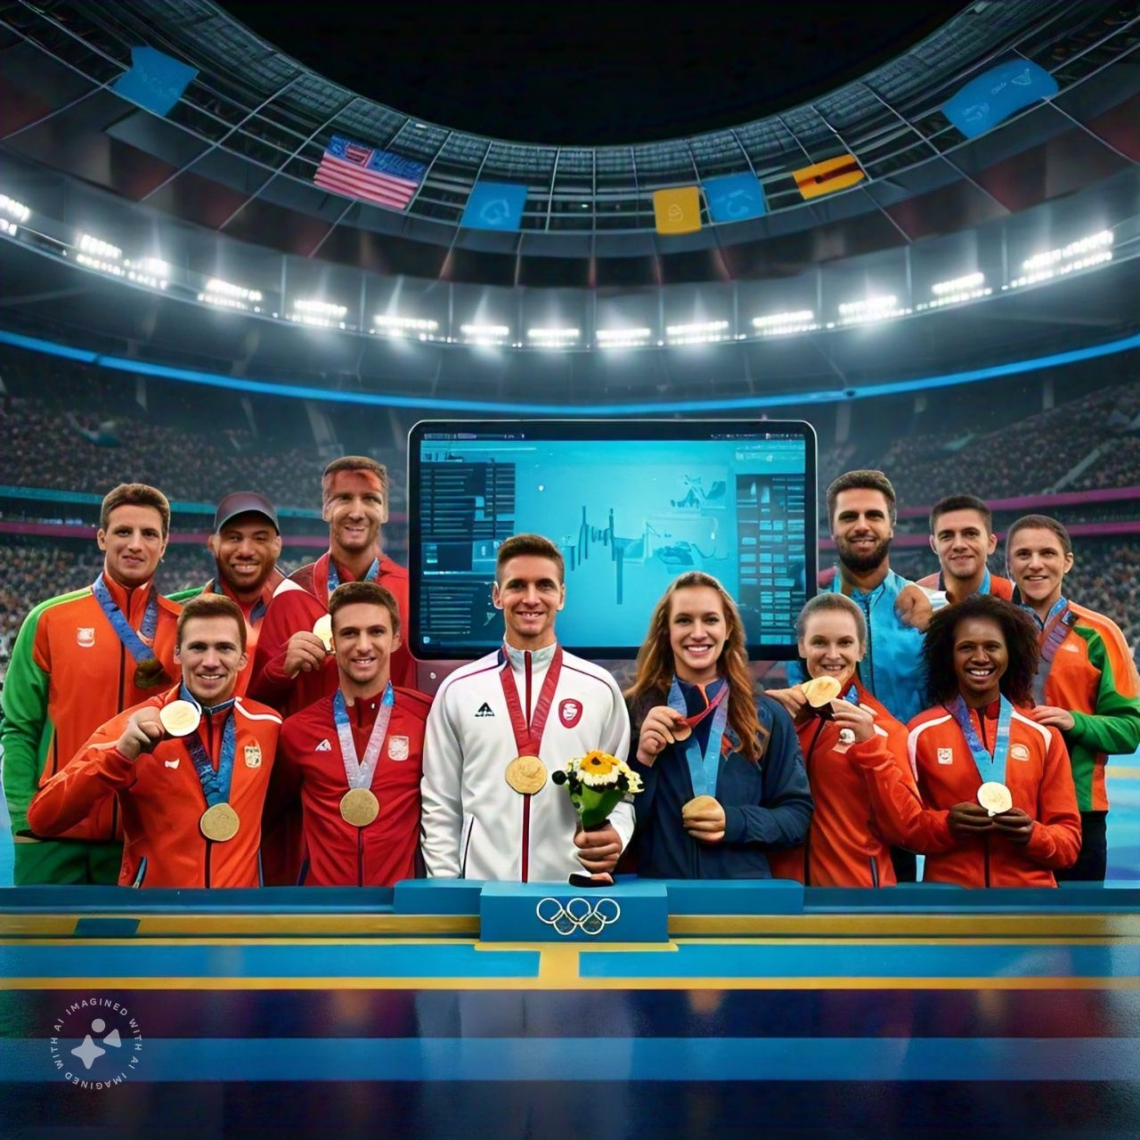
1) Introduction
2) Literature Review
3) Open Issues
4) Problem Statement
5)Proposed Architecture
6) Functional and Non-Functional Requirements
7)Low Level Design
8)Methodology
9) Implementation
10)Progress in Project so far
11)Experiment results and analysis
12)Testing and Validation
13)Conclusion
Olympics data analysis using machine learning algorithms

Slide 2

.
.
Introduction: Olympics data analysis using machine learning algorithm
Data-Driven Insights
Enhanced Decision Making
By analyzing large datasets of physical attributes and performance outcomes, the model can identify trends and correlations that may not be immediately obvious, such as how specific height and weight combinations influence success in different sports.
The model generates insights into which sport is best suited for an individual based on their unique physical profile, offering a tailored approach that increases the chances of success and satisfaction.
Analyzing data helps identify key factors that contribute to success in the Olympics
Coaches and athletes can make data-driven decisions about training, nutrition, and competition strategies.
Insights from data can guide personalized training programs tailored to individual athletes' strengths and weaknesses.

Slide 3
Literature Review
Author/Title/Year | Applied Methodology | Algorithm Used | Findings/ Results | Limitations
Likelihood of Winning Gold (2020)By Dr. Goutam Chakrabory, | Analysis of historical data for predicting future performance | Logistic algorithm | Predicted the likelihood of winning a gold medal in 2016 based on past performances in prior competitions. | Limited by the accuracy of historical data; may not account for changes in athlete
Analyzing Evolution of the Olympics by Exploratory Data Analysis (2021) by Rahul Pradhan | Predicition models | Linear regression | Estimated a person’s likelihood of earning a medal at the next Olympics based on previous results. | Complexity in Analysis(e.g., improvements in athlete training, health advancements, etc.).
Visualization & Statistical Analysis by Bogdan Radusinovic | Statistical visualization and performance analysis | Exploratory Data Analysis (EDA), Visualization | Applied visualizations (graphs, charts) to examine Olympic data, including performance | Relies heavily on available data quality and the ability to correctly interpret the visualizations;
Olympic game analysis and prediction using machine learning byManjushree M Kashaf Khan K S | Prediction using machine learning algorithm for accurate prediction | Logistic Regression and Random Forest | Application of machine learning in this field can help improve training strategies | Overfitting Bias and Fairness can crate and issue

Slide 4
Open Issues
Data Quality and Incompleteness:Missing or incomplete data can lead to inaccurate predictions and analysis, impacting the reliability of results.
Data Standardization: lack of uniformity in data formats and sources makes it difficult to aggregate and analyze Olympic data effectively.
Real-Time Data Processing: Handling and processing real-time data, such as live performance statistics, presents challenges due to the large volume and complexity.
Handling Multidimensional Data:Analyzing data across various dimensions (e.g., athlete demographics, environmental factors, competition conditions) requires advanced techniques and can be computationally intensive.
Bias and Fairness:Ensuring that machine learning algorithms do not reinforce biases or unfairly influence outcomes is an ongoing issue in Olympic data analysis.
Scalability of Models: Scaling machine learning models to handle the increasing volume of data from new Olympic events, more athletes, and additional variables is a key challenge.
Visualization Challenges: Presenting complex Olympic data in a way that is both comprehensible and actionable for decision-makers (coaches, athletes, organizers) remains difficult.

Slide 5
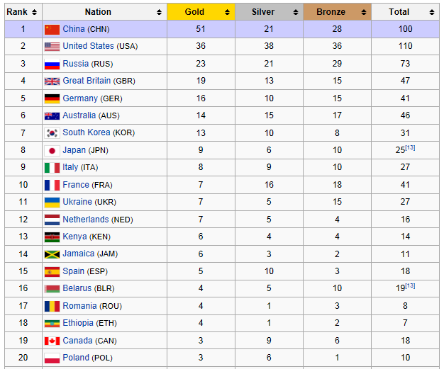
Problem Statement
despite the availability of vast amounts of data, there is a lack of systematic, data-driven approaches to predict and optimize Olympic outcomes such as medal distributions, athlete performances, and country rankings.
This research aims to address the following key problems:
Predicting Performance and Medal Outcomes
Analyzing Patterns in Athlete Performance
Enhancing Decision-Making for Coaches and Athletes
Handling the Complex and Diverse Nature of Olympic Data
Visualizing and Interpreting Results for Stakeholders:

Slide 6
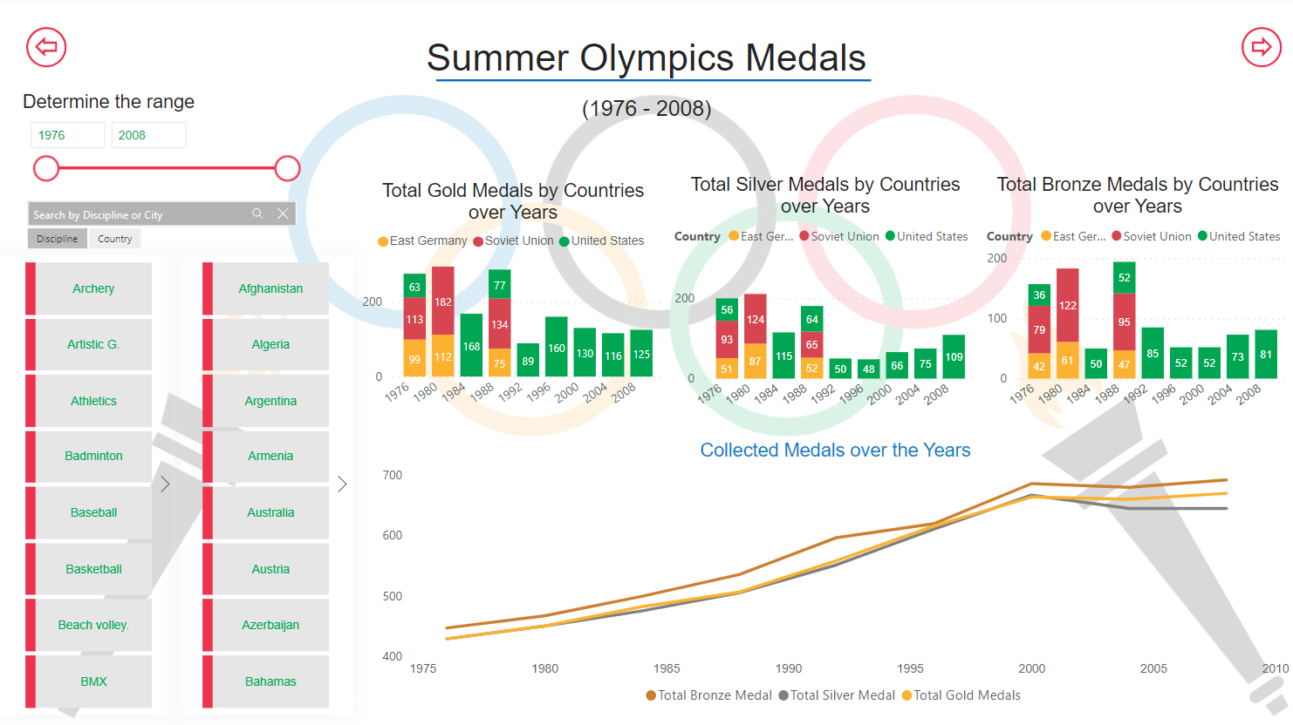
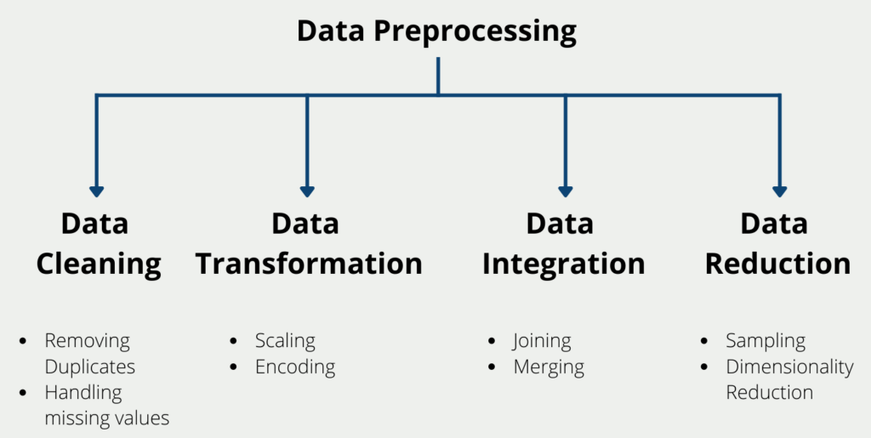
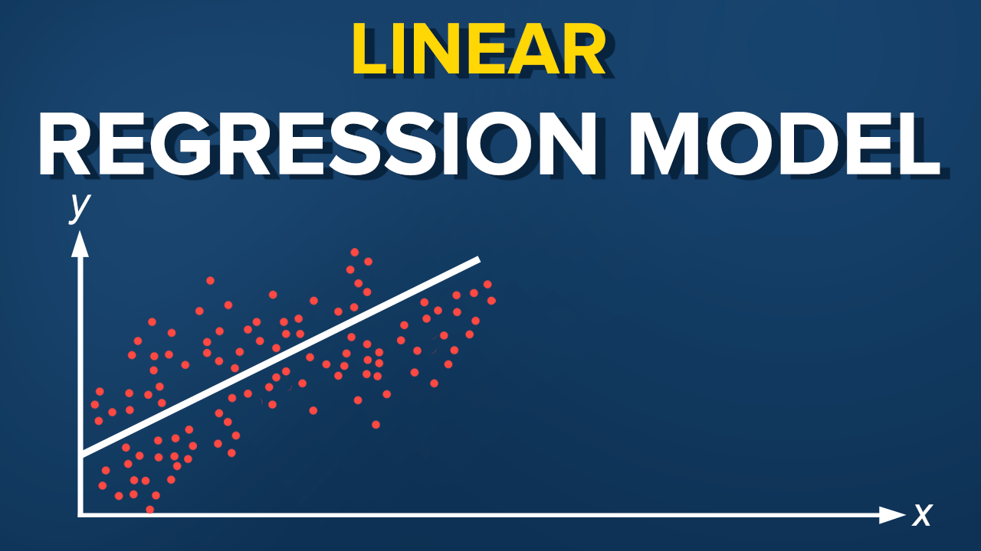
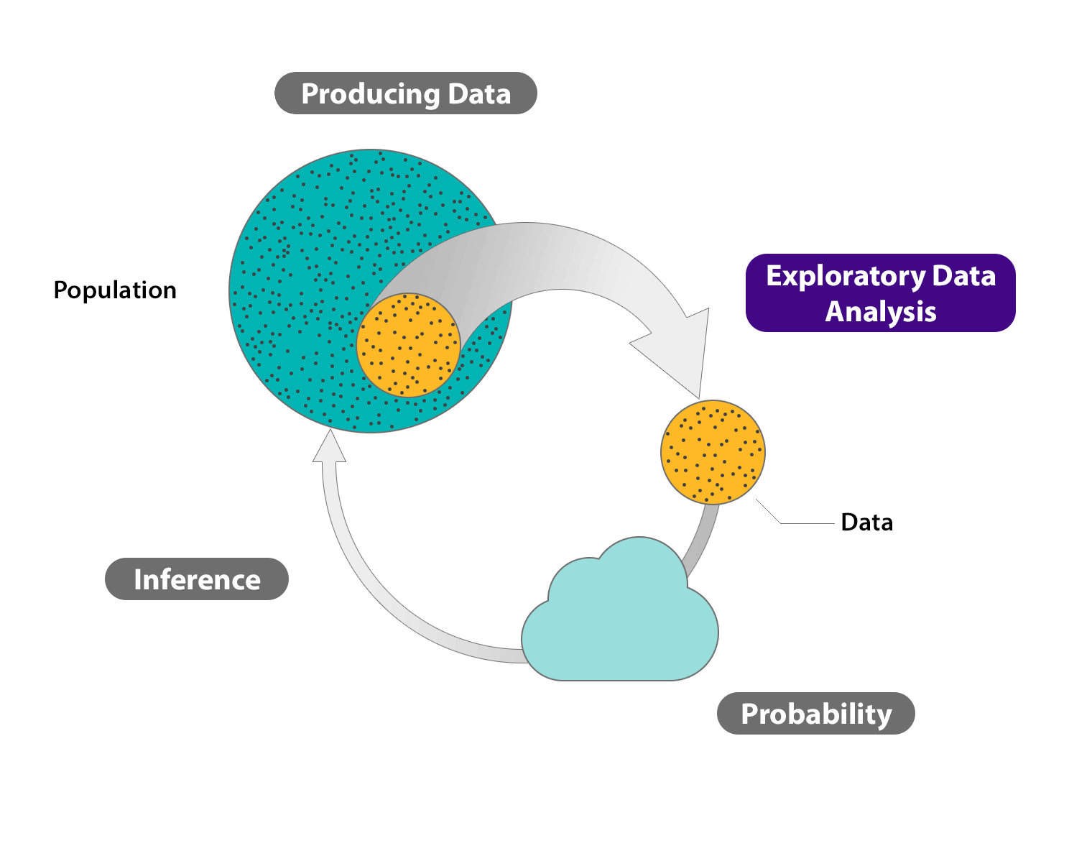
Proposed Architecture
Data Collection
Data Preprocessing
Machine Learning Algorithm

Slide 7
Low Level Design
Low-Level Design
Data collection structure (attributes like age, weight, sex, height).
Preprocessing pipeline for cleaning and normalization of data.
Detailed structure of the Linear Regression model (features, weights, bias).
Explanation of input/output processing flow.
Algorithm flowcharts or diagrams (input processing → model prediction → output recommendation).

Slide 8
Methodology
from pyspark.sql import SparkSession
from pyspark.sql.functions import col
from pyspark.ml.feature import VectorAssembler, StringIndexer
from pyspark.ml.regression import LinearRegression
from pyspark.ml.evaluation import RegressionEvaluator
spark = SparkSession.builder.appName("Athlete Event Prediction").getOrCreate()
data = spark.read.csv("/content/athlete_events.csv", header=True, inferSchema=True)
data.printSchema()
data = data.dropna(subset=["Sex", "Age", "Height", "Weight", "Sport", "Event"])
sex_indexer = StringIndexer(inputCol="Sex", outputCol="SexIndex")
sport_indexer = StringIndexer(inputCol="Sport", outputCol="SportIndex")
data = sex_indexer.fit(data).transform(data)
data = sport_indexer.fit(data).transform(data)
# Cast numerical columns to float
data = data.withColumn("Age", col("Age").cast("float"))
data = data.withColumn("Height", col("Height").cast("float"))
data = data.withColumn("Weight", col("Weight").cast("float"))

Slide 9
data.printSchema()
feature_cols = ["SexIndex", "Age", "Height", "Weight"]
assembler = VectorAssembler(inputCols=feature_cols, outputCol="features", handleInvalid="skip") # skip rows with invalid values
data = assembler.transform(data)
data = data.select(col("features"), col("SportIndex").alias("label"))
train_data, test_data = data.randomSplit([0.8, 0.2], seed=42)
lr = LinearRegression(featuresCol="features", labelCol="label", maxIter=10)
model = lr.fit(train_data)
predictions = model.transform(test_data)
evaluator = RegressionEvaluator(labelCol="label", predictionCol="prediction", metricName="rmse")
rmse = evaluator.evaluate(predictions)
print(f"Model RMSE: {rmse:.2f}")
print("\nEnter the following details to predict Sport: ")
sex = input("Enter Sex (Male/Female): ")
age = float(input("Enter Age: "))
height = float(input("Enter Height: "))
weight = float(input("Enter Weight: "))

Slide 10
sex_index = 1.0 if sex.lower() == "female" else 0.0 # Adjust indexing as per StringIndexer
input_data = spark.createDataFrame([(sex_index, age, height, weight)], feature_cols)
input_data = assembler.transform(input_data)
predicted_sport = model.transform(input_data)
predicted_sport.show()
predicted_sport_index = predicted_sport.select("prediction").collect()[0][0]
original_data = spark.read.csv(file_path, header=True, inferSchema=True)
sport_indexer_reverse = StringIndexer(inputCol="Sport", outputCol="SportName", handleInvalid="skip")
sport_indexer_reverse_model = sport_indexer_reverse.fit(original_data) # Fit the reverse indexer model on the original data
predicted_sport_name = sport_indexer_reverse_model.labels[int(predicted_sport_index)]
print(f"\nPredicted Sport: {predicted_sport_name}")
spark.stop()

Slide 11
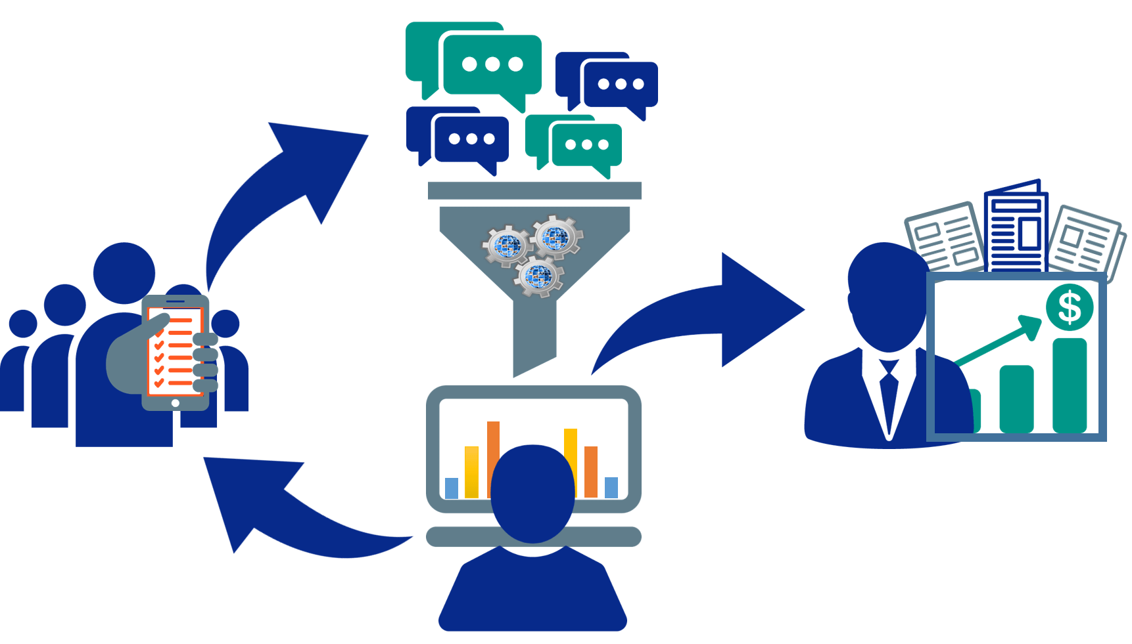
Data Collection
Objective: Gather extensive datasets to analyze the evolution of the Olympic Games over time.
Datasets Used:
Player Data: Includes player details such as gender, height, weight, country of origin, and medals earned (Gold, Silver, Bronze).
Nation Data: Includes statistics about the nations that participated in the Olympics and their total medals (Gold, Silver, Bronze).
Importance: A large and diverse dataset ensures more accurate results and stronger confidence in the conclusions

Slide 12
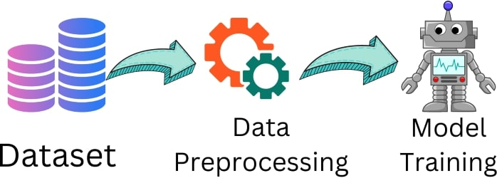

Data Preprocessing
Objective: Prepare the raw data for analysis by cleaning and transforming it into usable information.
Process:
Identification and Handling of Missing Data: Raw data often contains missing or inaccurate values (e.g., null values).
Deterministic Imputation: Replaces null values by using available data from the same column. Techniques like Basic Numeric Imputation (using mean or median values) or Hot Deck Imputation (replacing with a comparable dataset entry) are applied.
Goal: To remove inaccuracies and ensure that the dataset is clean and ready for further analysis.

Slide 13
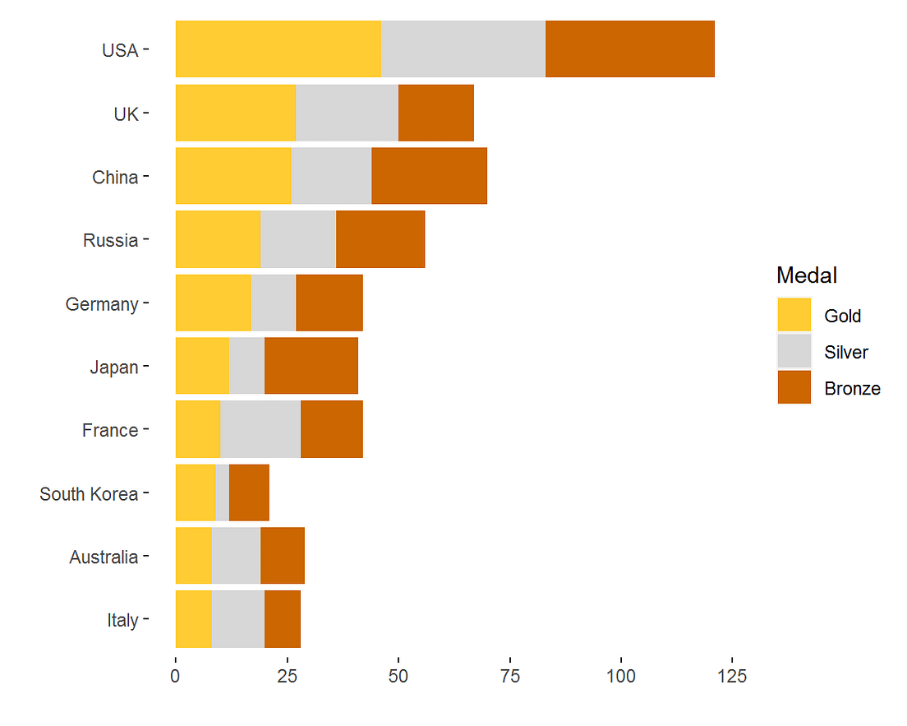
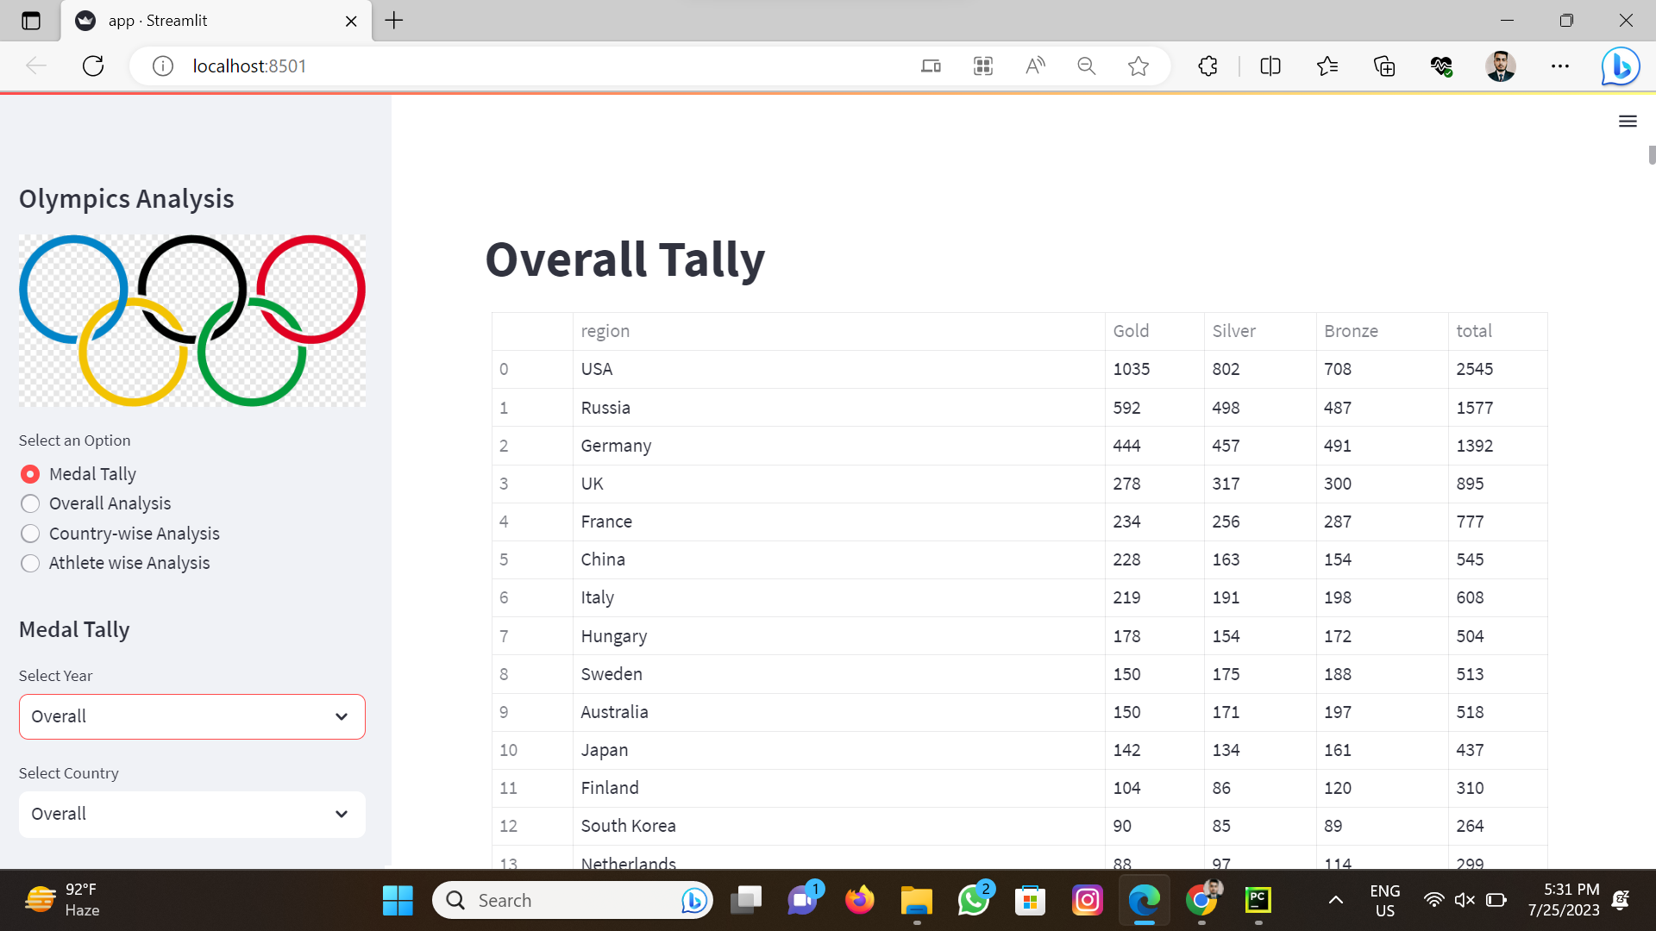
Exploratory Data Analysis (EDA):
Objective: Conduct a thorough examination of the cleaned data to uncover patterns, trends, and key characteristics.
Techniques Used:
Visualization: Create visual representations such as histograms, bar graphs, box plots, scatter plots, etc., to understand the distribution of data and relationships between different features.
Goal: To visualize and compare various aspects contributing to the evolution of the Olympic Games, helping researchers to draw insights about trends and changes over time.

Slide 14
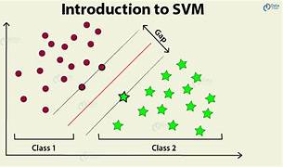
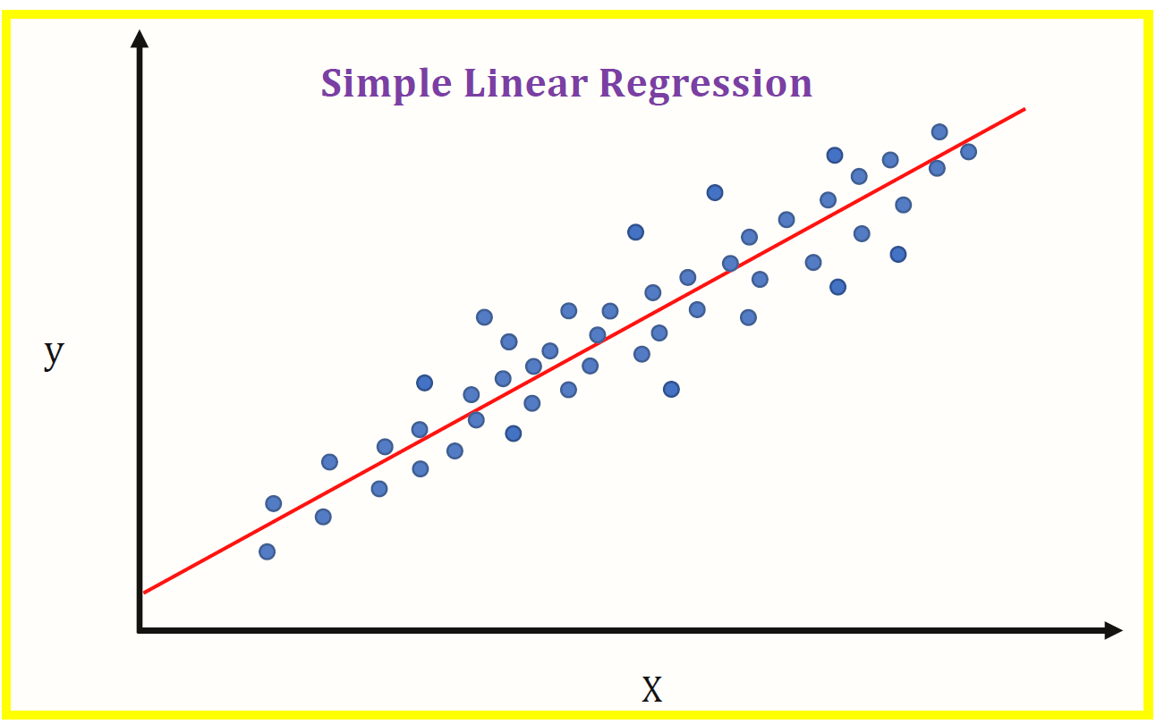
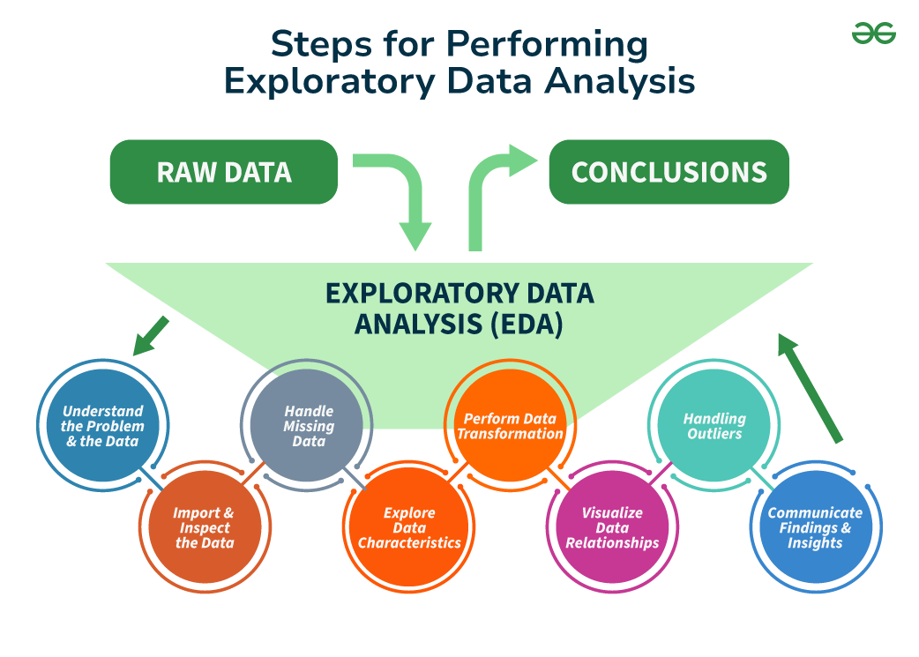
Machine Learning Algorithm Application
Objective: Apply machine learning models (e.g., linear regression, logistic regression, decision trees, SVM) to predict or analyze further insights.
Usage: While not explicitly mentioned, these algorithms could be used to predict future trends or classify certain outcomes based on historical data.

Slide 15
Functional Requirements and Non-Functional Requirements:
Functional Requirements
Non- Functional Requirements
. Data Collection and Integration
. Data Preprocessing
. Exploratory Data Analysis (EDA)
. Model Building and Training
. Model Evaluation and Performance Metrics
. Prediction and Decision Support:
. User Interaction
. Scalability
. Performance and Efficiency
. Accuracy
. Reliability
. Security and Privacy
. Usability
. Maintainability
. Interoperability
. Data Integrity

Slide 16
High Level Architecture And Design
Data Sources
Data Collection Layer
Data cleaning, transformation
Decision Support Layer
Machine Learning Layer
Exploratory Data Analysis Layer
User Interface
Model Refinement and Feedback

Slide 17
Results
Here are the results from the provided paragraph in bullet points:
attributes of the decision tree in the model.
Countries with more athletes have a higher likelihood of winning medals.
The United States has the most participants (17,847) and the most gold medals (2,638).
Increase in Female Athlete Participation:
The number of female athletes participating has significantly increased over time.
Summer vs. Winter Olympics:
More female athletes compete in the Summer Olympics than in the Winter Olympics.
Age Range of Highest Participation:
The age range with the highest participation is from 20 to 30 years old.
Age and Gold Medals:
Athletes aged over 60 have won all six of the Olympic gold medals in history.
Male Medal Winners' Physical Characteristics:
The majority of male medal winners are between 175 to 200 cm in height and weigh between 80 to 120 kg.
Female Medal Winners' Physical Characteristics:
The majority of female medal winners are between 150 to 170 cm in height and weigh between 50 to 75 kg.

Slide 18
Conclusion
The goal of the code is to provide insights into the Olympics, focusing on medal statistics, athlete performance, country-wise comparisons, and overall trends over time.
In summary, the code builds an interactive Streamlit application that allows users to explore and analyze Olympic data from various perspectives, such as by medals, athletes, countries, and overall trends.
The analysis focuses on the following key areas:
Medal Tally Analysis:
Allows users to view the medal tally for a selected country and year (or overall data).
Displays a table of medals earned by the selected country in a given year (or overall performance).
2. Overall Olympic Analysis:
Displays key statistics, such as the number of Olympic editions, cities, sports, events, athletes, and participating nations.
Shows various charts, such as:
Participating nations over time.
Number of events over time in each sport.
Successful athletes.
3. Country-wise Analysis:
Users can select a country to see its medal tally over the years.
A heatmap displays which sports the selected country excels in.
The top 10 athletes from the selected country are displayed.
4. Athlete-wise Analysis:
Provides analysis of athletes, including:
Distribution of athletes' ages (overall and broken down by medal types).
Distribution of ages of gold medalists in various sports.
Correlation between height and weight, with gender and medal information.
Gender participation trends over time (male vs female).

Slide 19
References
[1] Ahmed, Y. A., Ahmad, M. N., Ahmad, N., and Zakaria, N. H. (2019). Social media for knowledge-sharing: a systematic literature review. Telematics Inform. 37, 72–112. doi: 10.1016/j.tele.2018.01.01
[2] Fink, A.. (2019). Conducting Research Literature Reviews: From the Internet to Paper. 5th ed. Los Angeles, CA: Sage.
[3] Houlihan, B., Leopkey, B., and MacIntosh, E. (2017). Introduction: youth, sport and the youth olympic games. Int. J. Sport Manage. Mark. 4/5/6, 237–241.
[4] S. Bellavia, M. Macconi, B. Morini, An aMne scaling trust-region approach to bound-constrained nonlinear systems, Appl. Numer. Math. 44 (2003) 257–280.
[5] 120 years of Olympic Dataset, Available: https://www.kaggle.com/datasets/heesoo37/120-years-ofolympic-history-athletes-and-results.
[6] Kitchenham, B., Brereton, O. P., Budgen, D., Turner, M., Bailey, J., and Linkman, S. (2009). Systematic literature reviews in software engineering–A systematic literature review. Inform. Software Technol. 51, 7–15. doi: 10.1016/j.infsof.2008.09.009
[7] Abdelhamid, Neda, et al. "MAC: A multiclass associative classification algorithm." Journal of Information & Knowledge Management 11.02 (2012): 1250011.
[8] Nunes, S., & Sousa, M. (2006). Applying data mining techniques to football data from European championships. In Actas da 1ª Conferência de Metodologias de Investigação Científica (CoMIC'06).
[9] Fachao Li, Jinning Yang, Chenxia Jin, Mikhail Yu Kataev. (2017) A new attribute reduction method and its application in covering information systems. Enterprise Information Systems 11:7, pages 1043-1058.
[10](PDF) Analyzing Evolution of the Olympics by Exploratory Data Analysis using R

